Slide 1

Graduate School of Computer and Information Sciences
Computer Fundamentals
  Parallel and distributed computing, from algorithms, languages, compilers, architectures to systems.
Information Systems
  Software engineering, from software modelling, analysis, design, to verification and validation
Media Science
  Computer graphics, image processing, voice processing, pattern recognition, and GPU design
Computer and Information Sciences for Globalization
  Topics are related to applied technologies of software development and engineering towards globalization in Computer and Information Sciences
  http://cis.k.hosei.ac.jp/en/info/faculty

Slide 2
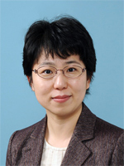
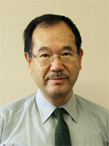
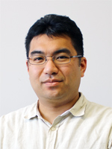

Professors and research areas (master’s and doctoral program)
Wide range of research areas
  Computer and Information Sciences (Computer Sciences)
Mina AKAISHI
Research area:
Narrativity based Information Access
Management/Analysis/Visualization
for Knowledge Media
Historical Knowledge-Based Science
Nobuhiko KOIKE
Research area:
Software Engineering
Soichiro HIDAKA
Research area:
Programming Languages
Program Transformations
Bidirectional Transformations and
their Applications to Model Driven Engineering
Satoshi OBANA
Research area:
Cryptography
Information Security
Notes:
＜教員研究分野の説明＞

Slide 3
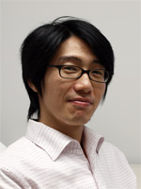
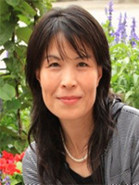
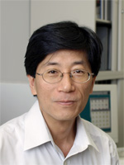
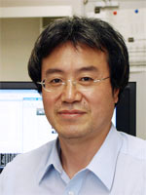
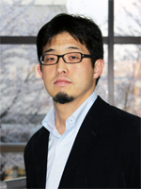
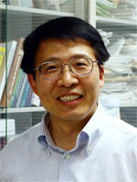
  Professors and research areas (Computer Sciences)
Akira SASAKI
Research area:
Programming Languages
Domain Specific Languages
Attribute Grammars
Runhe HUANG
Research area:
Artificial Intelligence
Machine Learning
http://cis.k.hosei.ac.jp/~rhuang/
Yuji SATO
Research area:
Evolutionary Computation
Machine Learning
Yamin LI
Research area:
Computer Architecture
Parallel and Distributed Systems
Mobile Ad Hoc Networks
http://cis.k.hosei.ac.jp/~yamin/
Toshio HIROTSU
Research area:
Internet
Operating System
Distributed Computing
Ubiquitous Computing
Shaoying LIU
Research area:
Software Engineering
Formal Engineering Methods
Intelligent Software Engineering
http://cis.k.hosei.ac.jp/~sliu/
Notes:
＜教員研究分野の説明＞

Slide 4
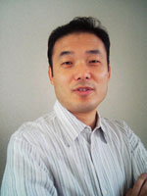
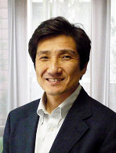
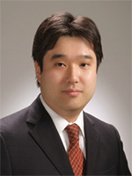
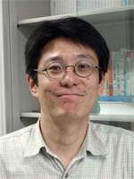
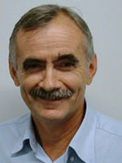
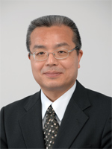
  Professors and research areas (Media Sciences)
Katunobu ITOU
Research area:
Speech Recognition
Multi-Modal Dialog System
Speech Interface
Yasunari ZEMPO
Research area:
Computational materials science
Development of computational techniques
for material design and property prediction
Large-scale parallel computing
Takafumi KOIKE
Media technologies connected
between real world and cyber world
Real-time computer graphics
Augmented reality
Computational photography
3D imaging
Toshihisa NISHIJIMA
Doctor (Engineering)
Research area:
Coding Theory
Information Theory
Vladimir SAVCHENKO
Research area:
Geometric Modeling
CG
Animation
http://www.k.hosei.ac.jp/~vsavchen/
Hiroshi HANAIZUMI
Research area:
Image Processing
Related site:
Notes:
＜教員研究分野の説明＞

Slide 5
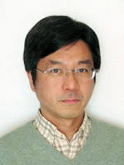
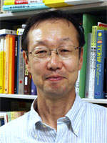
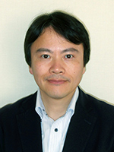
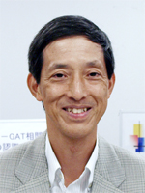
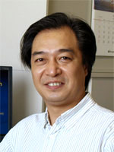
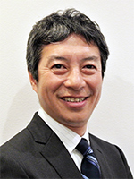
  Professors and research areas (Media Sciences)
Satoru FUJITA
Research Areas
Multi-agent systems
Human probing, IoT
Web services
Shuichi YUKITA
Research area:
Cellular Automata Theory
Algorithmic Mathematics
Mathematical Visualization
Hiroshi HOSOBE
Research area:
User Interfaces
Information Visualization
Computer Graphics
Constraint Programming
Toru WAKAHARA
Research area:
Intelligent Image Processing
Pattern Recognition
Jianhua MA
Ubiquitous Network and Computing
Smart Object, Space and Service
Autonomic and Trusted System
http://cis.k.hosei.ac.jp/~jianhua/
Kaoru UCHIDA
Pattern recognition and its real-world applications, Biometrics
Business innovation through computer and information sciences
Notes:
＜教員研究分野の説明＞

